Slide 1

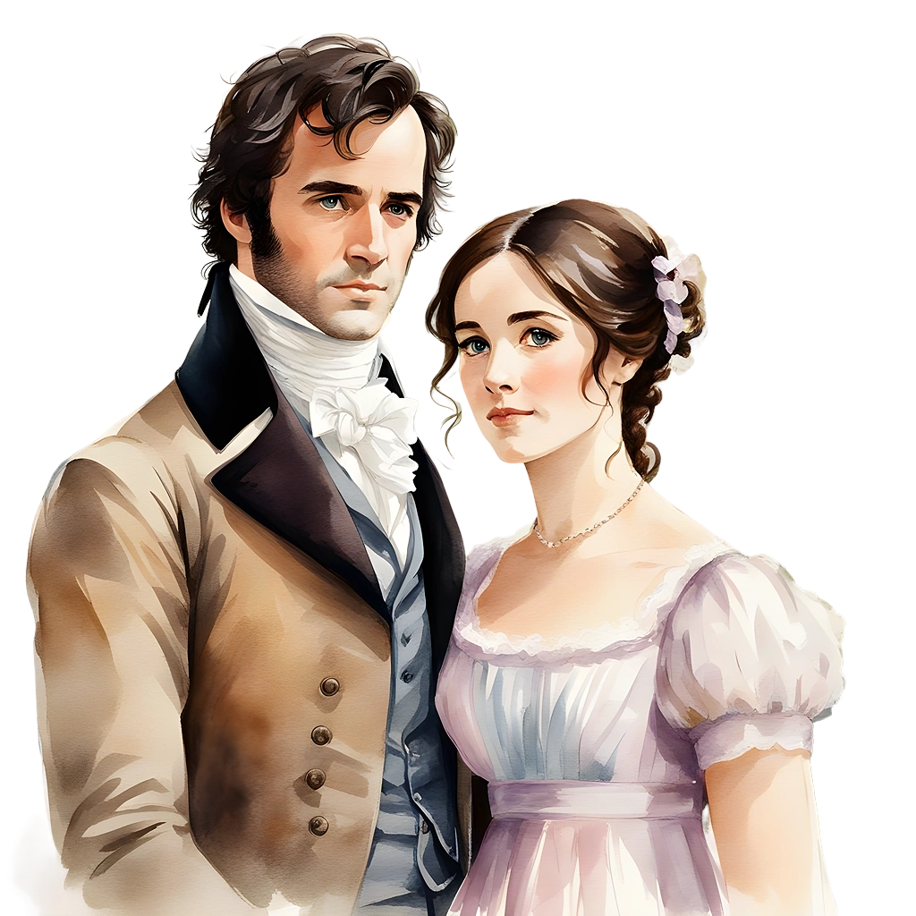

Pride and Prejudice
Here is where your presentation begins

Slide 2
Contents of this template
You can delete this slide when you’re done editing the presentation
Fonts | To view this template in PowerPoint, download and install the fonts we used
Used and alternative resources | An assortment of graphic resources that are suitable for use in this presentation
Thanks slide | You must keep it so that proper credits for our design are given
Colors | All the colors used in this presentation
Icons and infographic resources | These can be used in the template, and their size and color can be edited
Editable presentation theme | You can edit the master slides easily. For more info, click here
For more info: SLIDESGO | BLOG | FAQs
You can visit our sister projects: FREEPIK | FLATICON | STORYSET | WEPIK | VIDEVO

Slide 3
Table of contents
01
02
03
04
Introduction to Pride and Prejudice
Summary, themes and literary analysis
You can describe the main topic of the section here
You can describe the main topic of the section here
Historical and social context
Activities to prove your knowledge
You can describe the main topic of the section here
You can describe the main topic of the section here

Slide 4
Whoa!
This can be the part of the presentation where you introduce yourself, write your email…

Slide 5

01
Introduction to Pride and Prejudice
You can enter a subtitle here if you need it

Slide 6
Introduction to Pride and Prejudice
Mercury is the closest planet to the Sun and the smallest one in the entire Solar System. Contrary to popular belief, this planet's name has nothing to do with the liquid metal. Mercury was named after a Roman god
Mercury takes a little more than 58 days to complete its rotation, so try to imagine how long days must be there! Since the temperatures are so extreme, Mercury has been deemed to be non-habitable for humans

Slide 7

Significance and impact of the novel
Do you know what helps you make your point crystal clear? Use lists:
They’re simple
You can organize your ideas
You’ll never forget to buy milk!
And the most important thing: the audience won’t miss the point of your presentation ever again

Slide 8
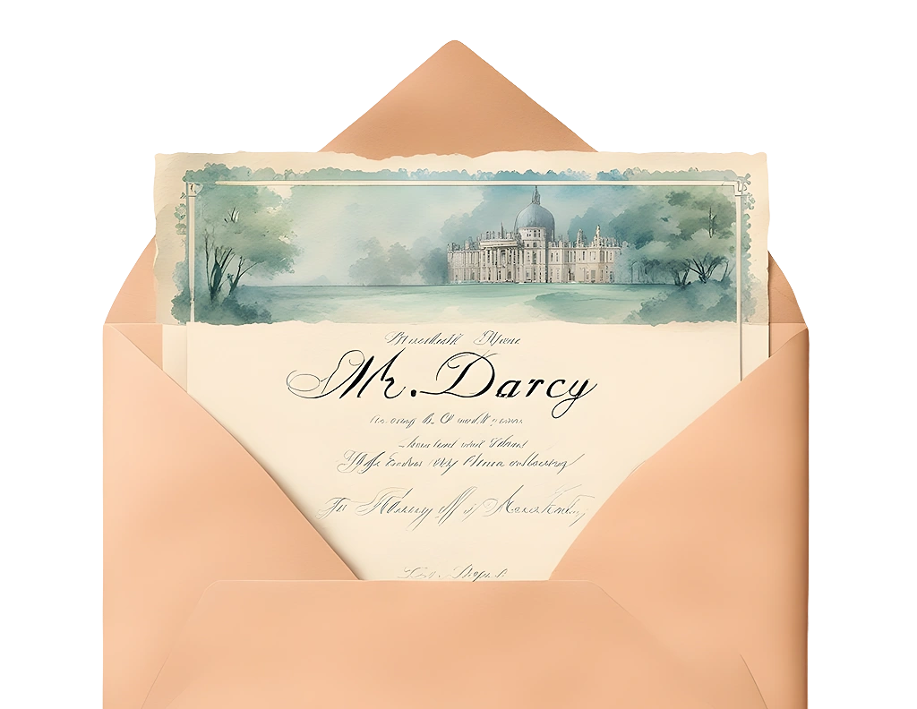
Overview of the main characters
Elizabeth Bennet
Mercury is the closest planet to the Sun and the smallest one in the Solar System
Mr. Fitzwilliam Darcy
Venus has a beautiful name and is the second planet from the Sun.

Slide 9
Main themes of the novel
Love
Class
Prejudice
Mercury is the closest planet to the Sun and the smallest one in the entire Solar System
Venus has a beautiful name and is the second planet from the Sun. It’s terribly hot
Earth is the third planet from the Sun and the only one that harbors life in the Solar System

Slide 10
The main settings of the novel
Longbourn
Netherfield Park
Mercury is the closest planet to the Sun and the smallest one in the entire Solar System
Venus has a beautiful name and is the second planet from the Sun. It is hot
Meryton
Rosings Park
Earth is the third planet and the only one that harbors life in the Solar System
Despite being red, Mars is a actually a very cold place. It is full of iron dust

Slide 11
Other important characters
Jane Bennet
Mr. Bingley
Mr. Wickham
Mercury is the closest planet to the Sun and the smallest one
Venus has a cute name and is the second planet from the Sun
Earth is the third planet and the only one that harbors life
Lydia Bennet
Charlotte Lucas
Mr. Collins
Mars is actually a cold place. It is full of iron oxide dust
Jupiter is a gas giant and the biggest planet in the Solar System
Saturn is a gas giant and is composed by hydrogen and helium

Slide 12
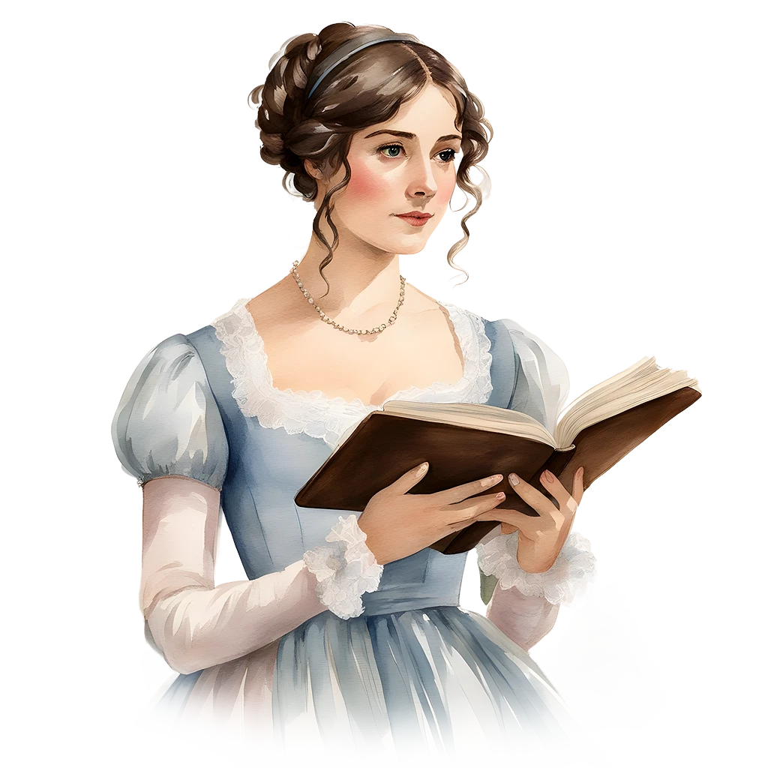

—Someone Famous
“This is a quote, words full of wisdom that someone important said and can make the reader get inspired”

Slide 13

An image always reinforce the concept
Images reveal large amounts of data, so remember: use an image instead of a long text. Your audience will appreciate it

Slide 14
Key aspects of the writing style of the novel
25%
50%
75%
Satire
Irony
Indirect speech
Mercury is the closest planet to the Sun and the smallest one
Venus has a cute name and is the second planet from the Sun
The Earth is the only planet that harbors life in the Solar System

Slide 15

Computer mockup
You can replace the image on the screen with your own work. Just right-click and select “Replace image”

Slide 16
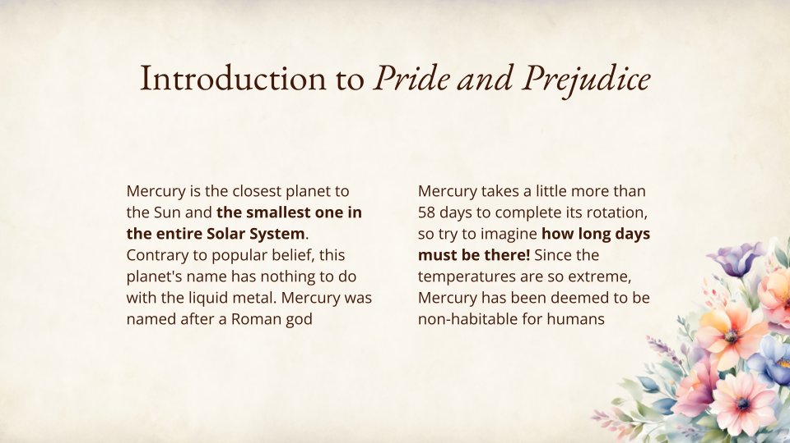
Tablet mockup
You can replace the image on the screen with your own work. Just right-click and select “Replace image”

Slide 17
Where does Pride and Prejudice take place?
England
Mercury is the closest planet to the Sun and the smallest of them all. Mercury was named after the Roman god

Slide 18
Key events in Pride and Prejudice
The arrival
Proposal/rejection
Mercury is the closest planet to the Sun
The Earth is the only planet that harbors life
Part I
Part II
Part III
Part IV
Romance
Marriages
Venus has a cute name and is the second planet
Despite being red, Mars is actually a cold place

Slide 19
Character analysis
Character | General description | Characteristics | Development
Elizabeth Bennet | Mercury is the smallest planet | It has craters It is a hot planet | It was named after a Roman god
Fitzwilliam Darcy | Venus is the second planet | It is very hot Its name is cute | Its atmosphere is very poisonous
Jane Bennet | Earth is the planet where we live | It the third It harbors life | It is also known as the Blue Planet
Charles Bingley | Mars is actually a very cold place | It is a red planet It is very cold | It was named after a Roman god

Slide 20
Gender roles in Pride and Prejudice
Marriage as a transaction
High social expectations
Gender roles in the early 19th century England
Mercury is the closest planet to the Sun
The Earth is the third planet from the Sun
No opportunities for women
Double standards for men/women
Venus is the second planet from the Sun
Despite being red, Mars is actually a cold place

Slide 21

Character relationships in the novel
50% - Elizabeth & Darcy
Mercury is the smallest planet
30% - Jane & Bingley
Venus is hot and has a cute name
20% - Other
Earth is the planet where we live
Follow the link in the graph to modify its data and then paste the new one here. For more info, click here

Slide 22
Choose the correct answer
Directions: Read each question carefully and choose the correct answer
01
Who is the wealthy and reserved gentleman initially perceived as proud and aloof?
02
Which character represents traditional gender expectations in the novel?
A
Mr. Bingley
A
Lady Catherine de Bourgh
B
Mr. Collins
B
Elizabeth Bennet
C
Mr. Darcy
C
Jane Bennet

Slide 23
True or false
Directions: Read the statements and determine whether each one is true or false
Statements | True | False
Mr. Collins proposes to Elizabeth Bennet, but she rejects his proposal
Jane Bennet marries Mr. Bingley in the end
Mr. Collins proposes to Elizabeth Bennet, and she declines
Charlotte Lucas marries Mr. Collins for financial security
Elizabeth Bennet's first impression of Mr. Darcy is positive

Slide 24
Connect the columns
Directions: Match the statement with the correct word
Eldest Bennet sister, admired for her beauty
Mr. Fitzwilliam Darcy
Wealthy gentleman initially perceived as proud
Mr. George Wickham
The youngest Bennet sister, impulsive and flirtatious
Mr. Collins
Marries Charlotte Lucas for financial security
Jane Bennet
Despite his charm, he is deceitful and manipulative
Lydia Bennet

Slide 25
Answer the questions
Directions: Test your knowledge and answer the following questions
01
Who elopes with Mr. Wickham, causing a scandal in the novel?
Write your answer here…
02
What social class do the Bennet family and Mr. Darcy belong to?
Write your answer here…
03
Who ultimately helps resolve the scandal caused by Lydia's elopement?
Write your answer here…

Slide 26
Write a short essay
Directions: Write a short essay about your favorite character from Pride and Prejudice
Describe the character's personality and behavior
Analyze how the character evolves or changes throughout the novel
Examine the character's role in the overall plot
Explain why this character is your favorite
Write your essay here…

Slide 27
Word search puzzle
Directions: Find the following concepts in the word search puzzle
ELIZABETH
DARCY
JANE
BINGLEY
LYDIA
COLLINS
A | S | D | C | O | L | L | I | N | S | F | G | D | H
J | B | I | N | G | L | E | Y | L | P | O | I | A | U
U | Y | T | R | E | W | Q | Z | J | X | C | V | R | B
N | M | B | Q | L | Y | D | I | A | R | T | U | C | S
S | C | G | H | U | J | T | L | N | M | Z | A | Y | X
E | U | E | L | I | Z | A | B | E | T | H | I | O | S

Slide 28
Thanks!
Do you have any questions?
youremail@freepik.com
+34 654 321 432
yourwebsite.com
Please keep this slide for attribution

